Slide 1

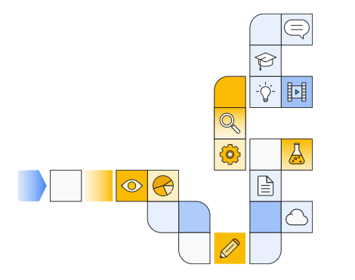

Google cloud generative ai overview Part 3
Notes:
https://www.cloudskillsboost.google/paths/118/course_templates/388

Slide 2
Vertex AI Overview
Notes:
https://www.youtube.com/watch?v=OovyG8O3jOQ

Slide 3

Notes:
https://www.youtube.com/watch?v=OovyG8O3jOQ

Slide 4
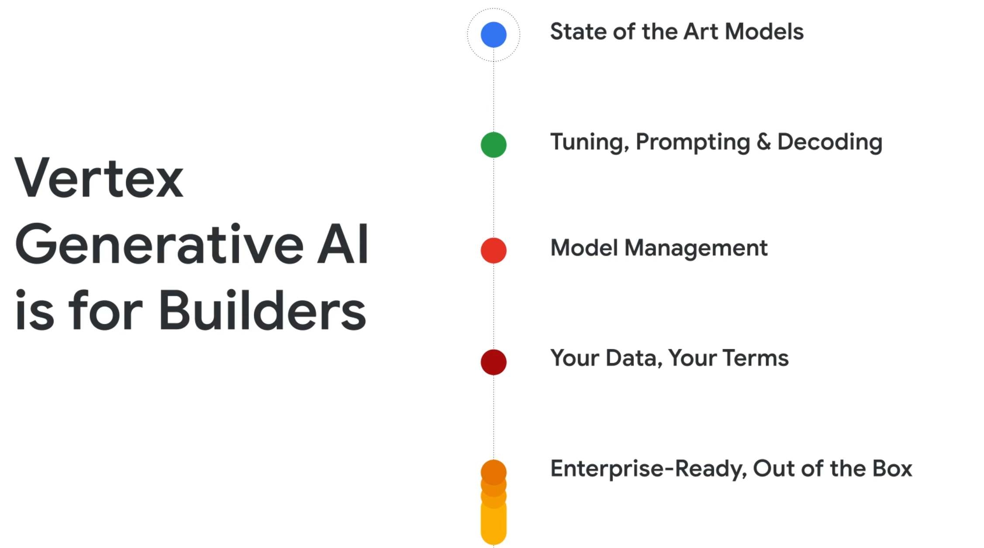

Slide 5
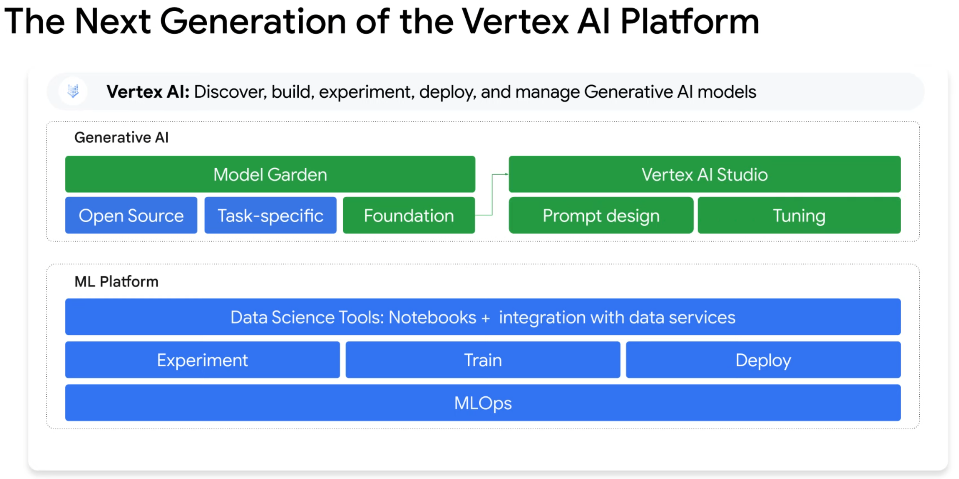

Slide 6
Understanding the model garden
Notes:
https://www.youtube.com/watch?v=Vy6iDBKkqhg

Slide 7
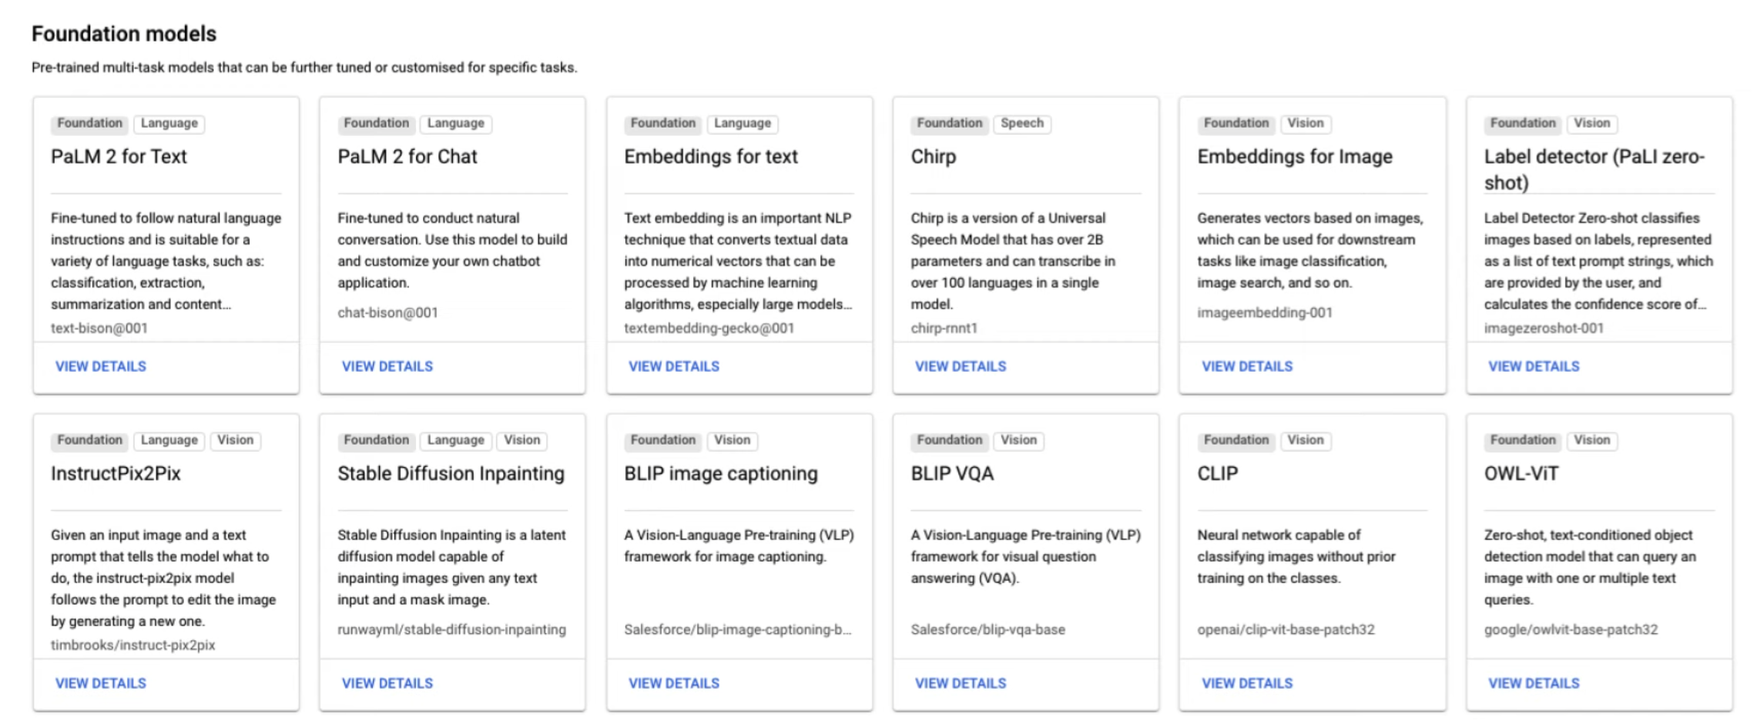

Slide 8
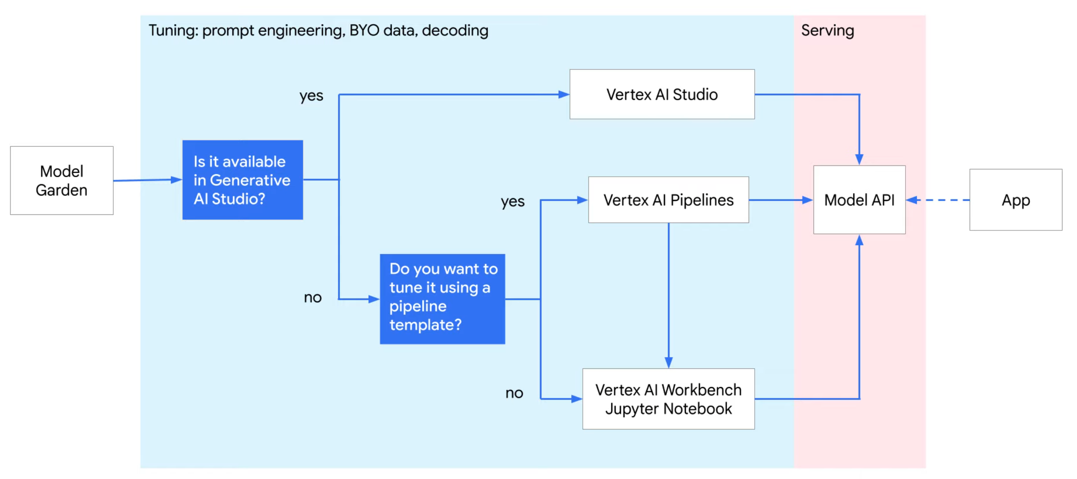

Slide 9
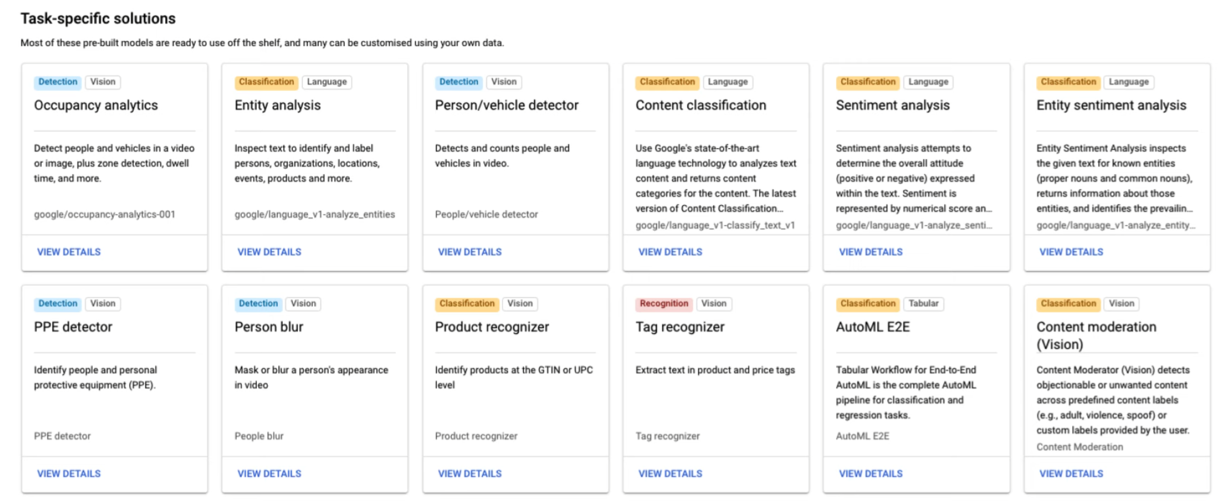

Slide 10
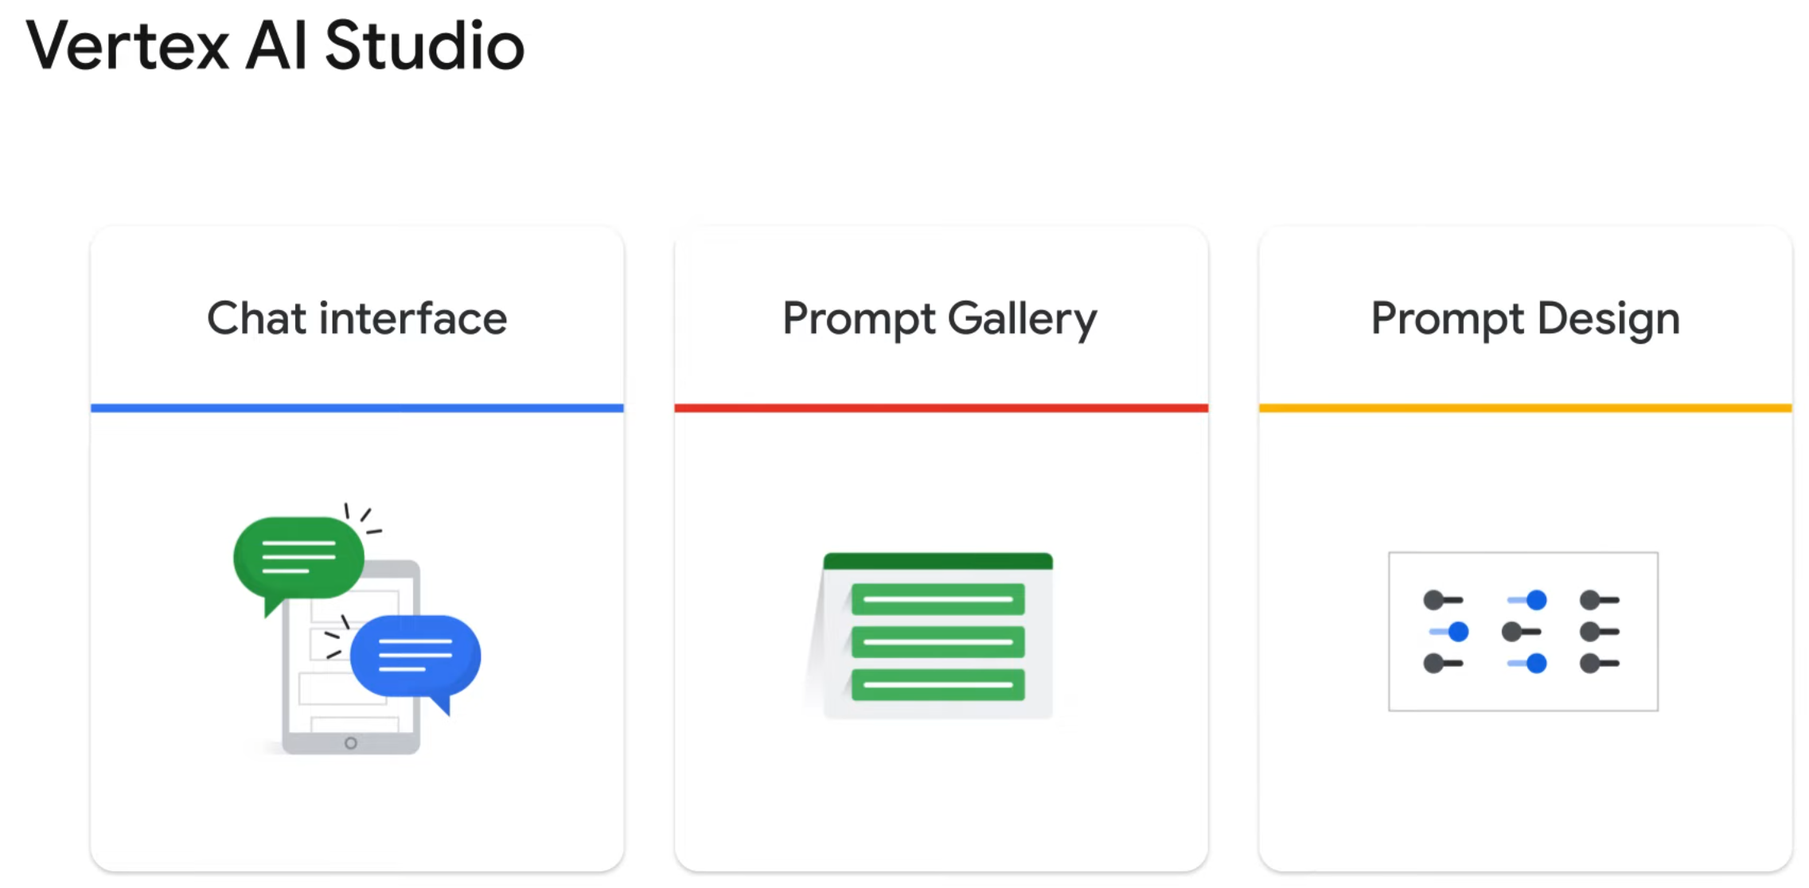

Slide 11
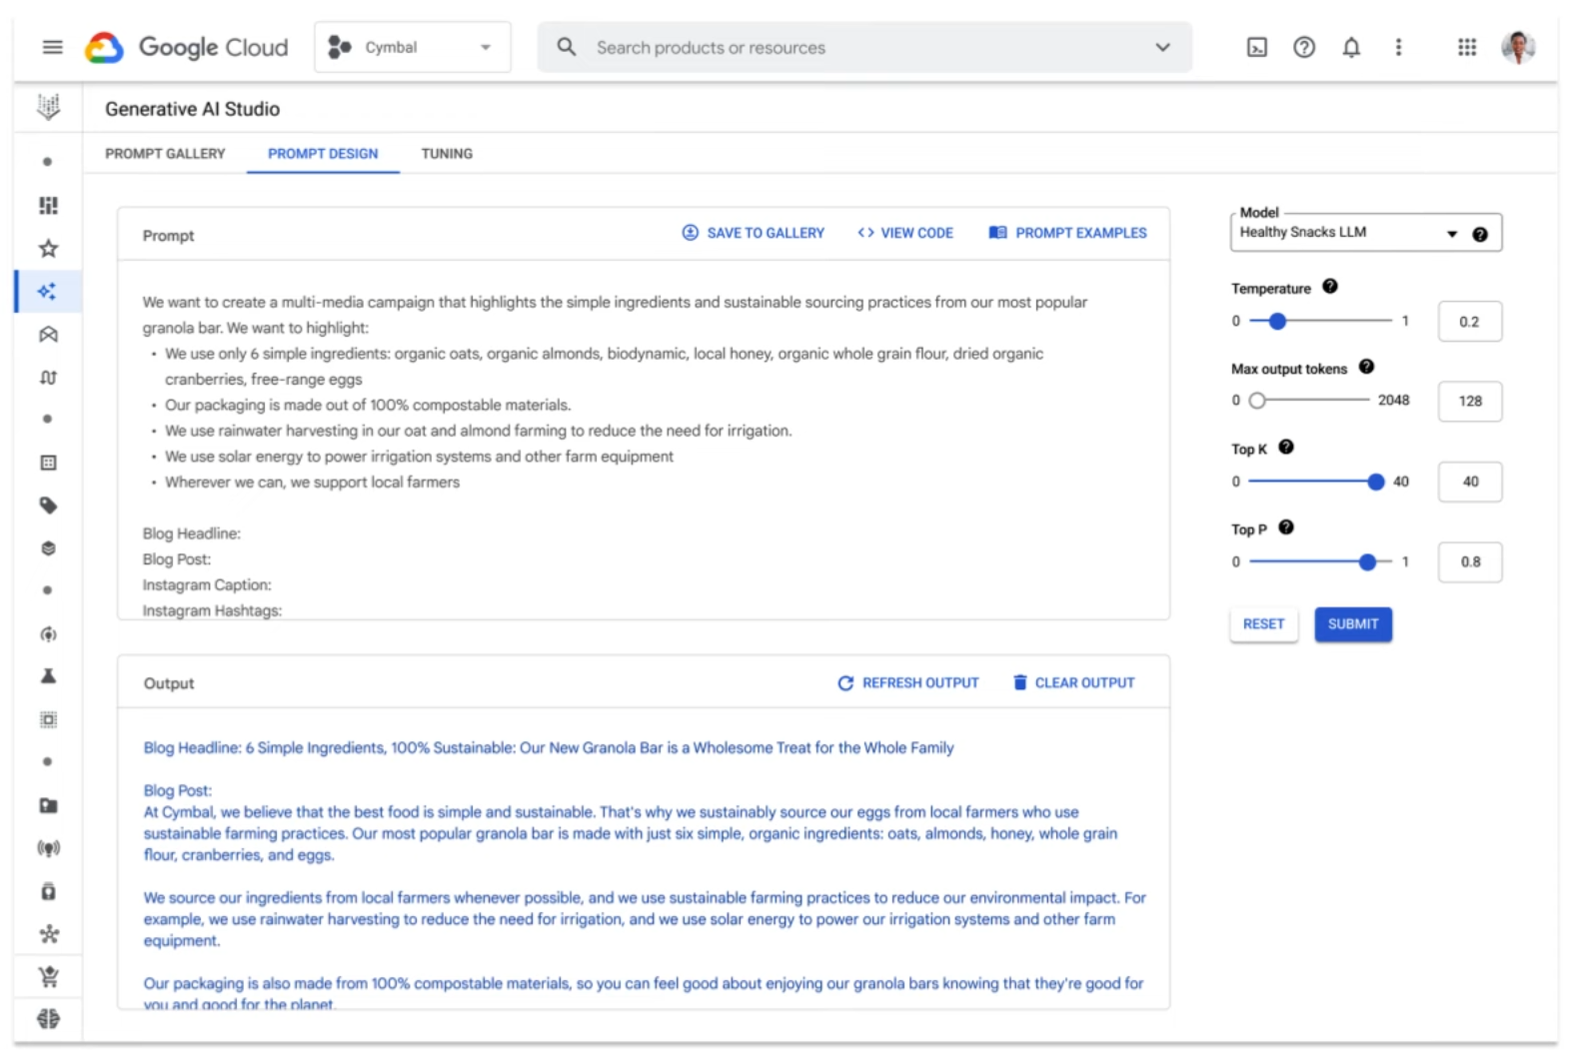

Slide 12
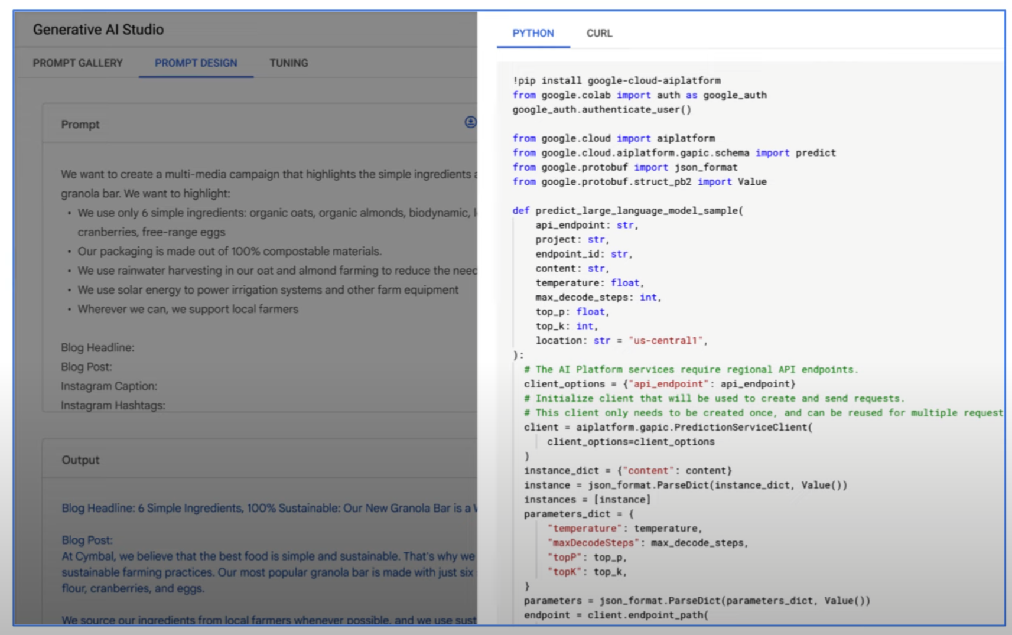

Slide 13
Foundation Models
Notes:
https://www.youtube.com/watch?v=H_EwYzq2pU0
https://www.youtube.com/watch?v=PfVO7BjT8kM

Slide 14
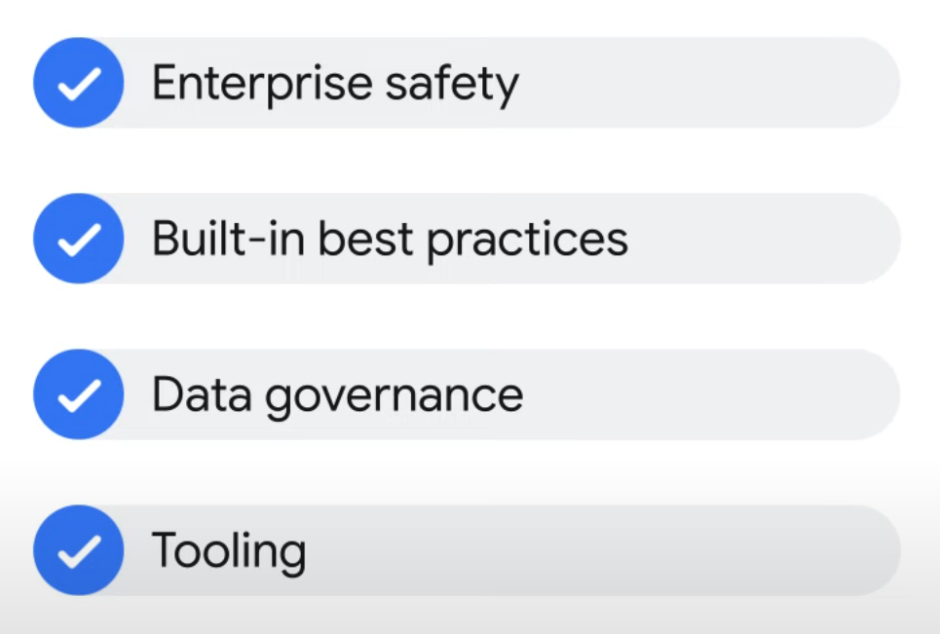
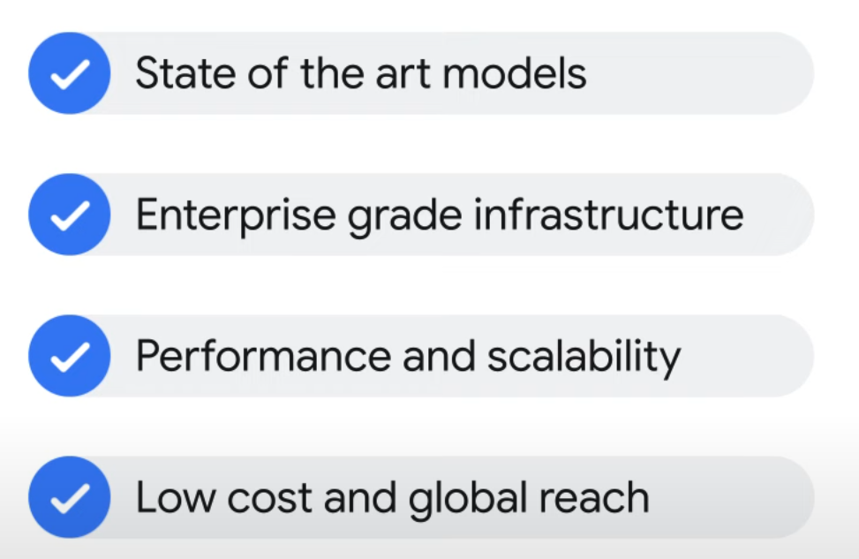

Slide 15
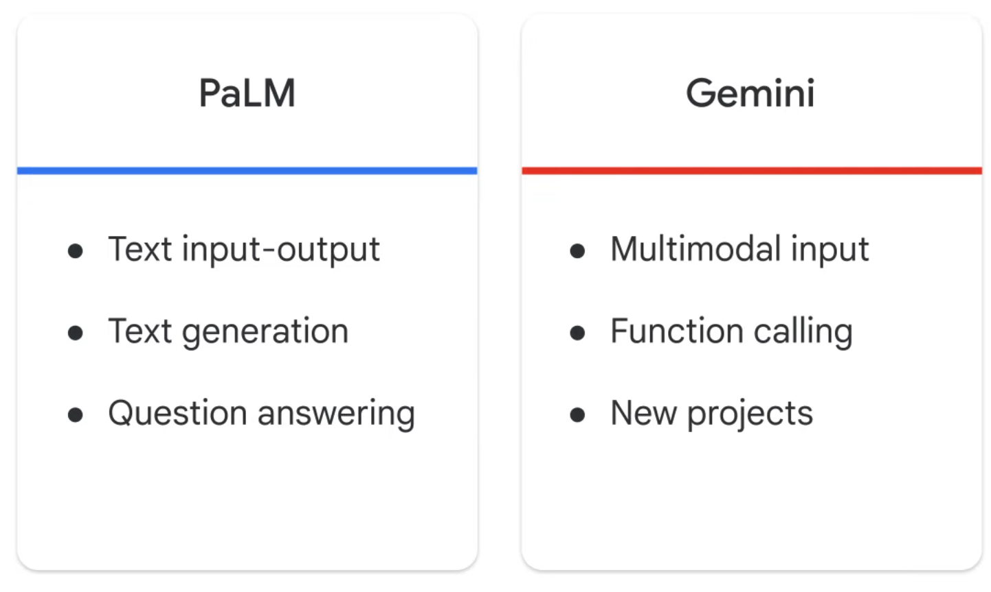

Slide 16
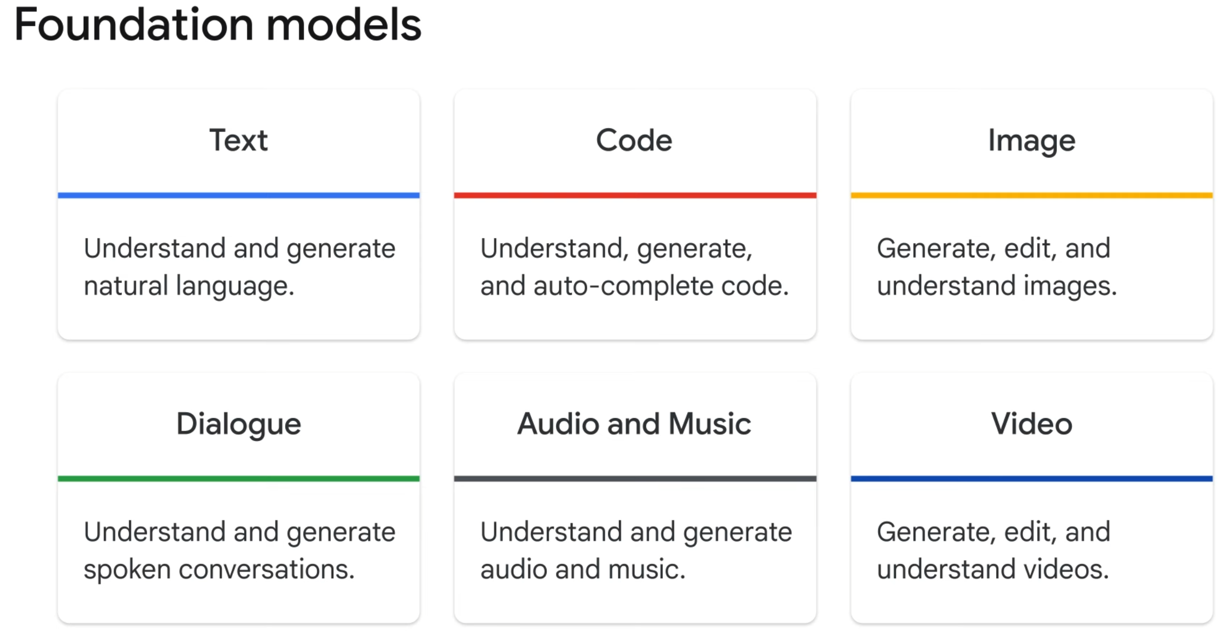

Slide 17
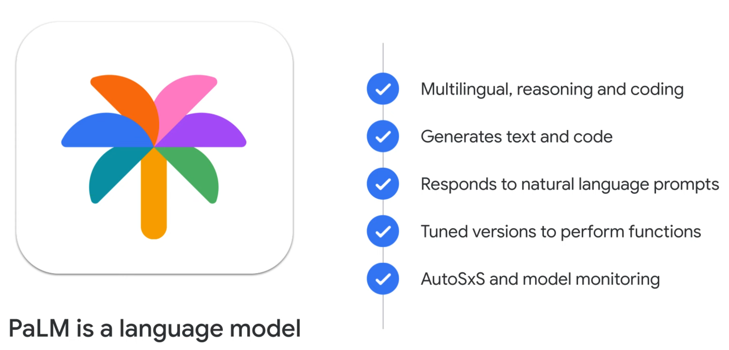

Slide 18
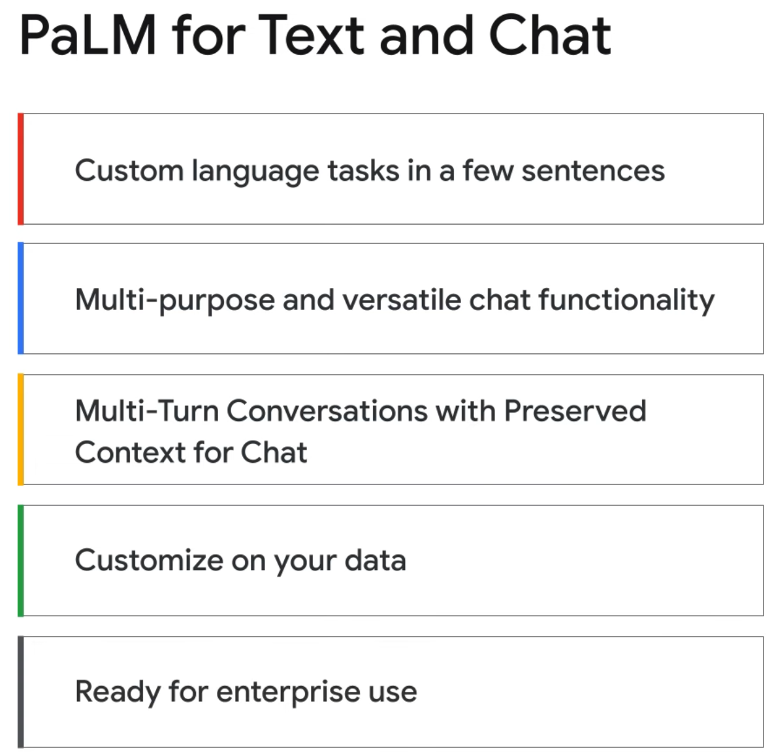

Slide 19
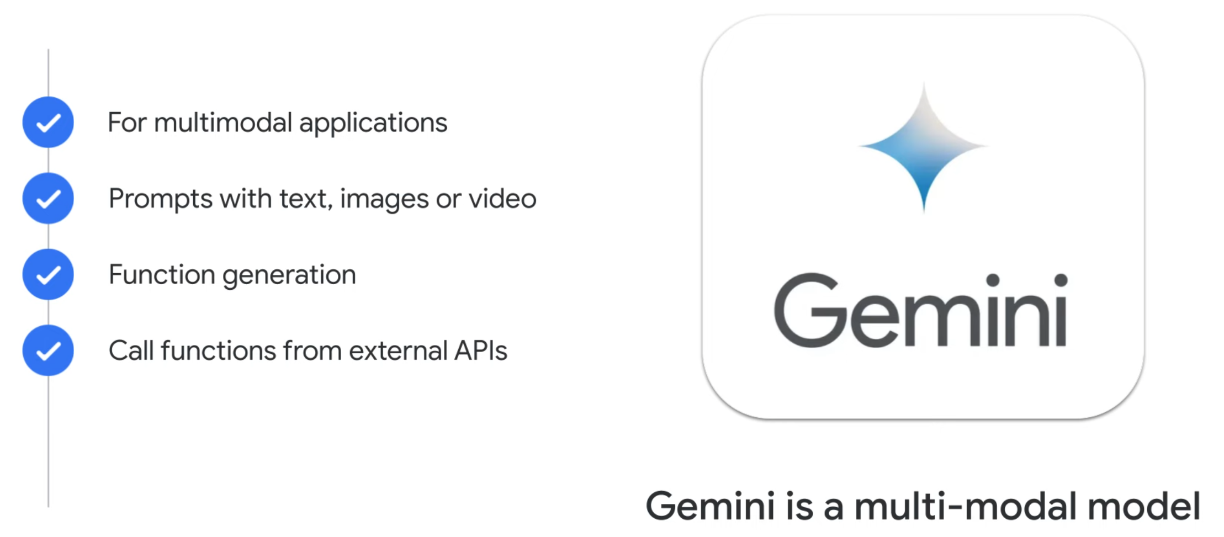

Slide 20
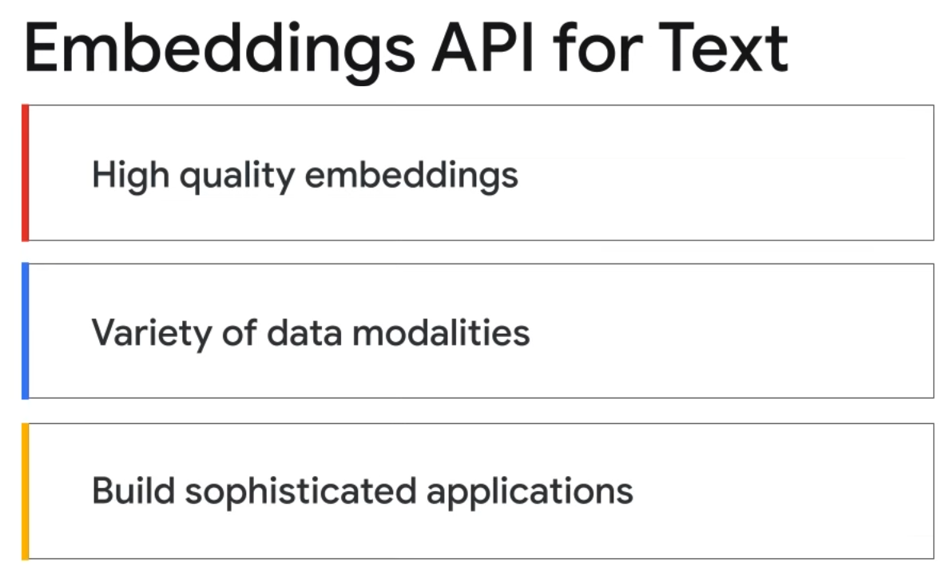

Slide 21
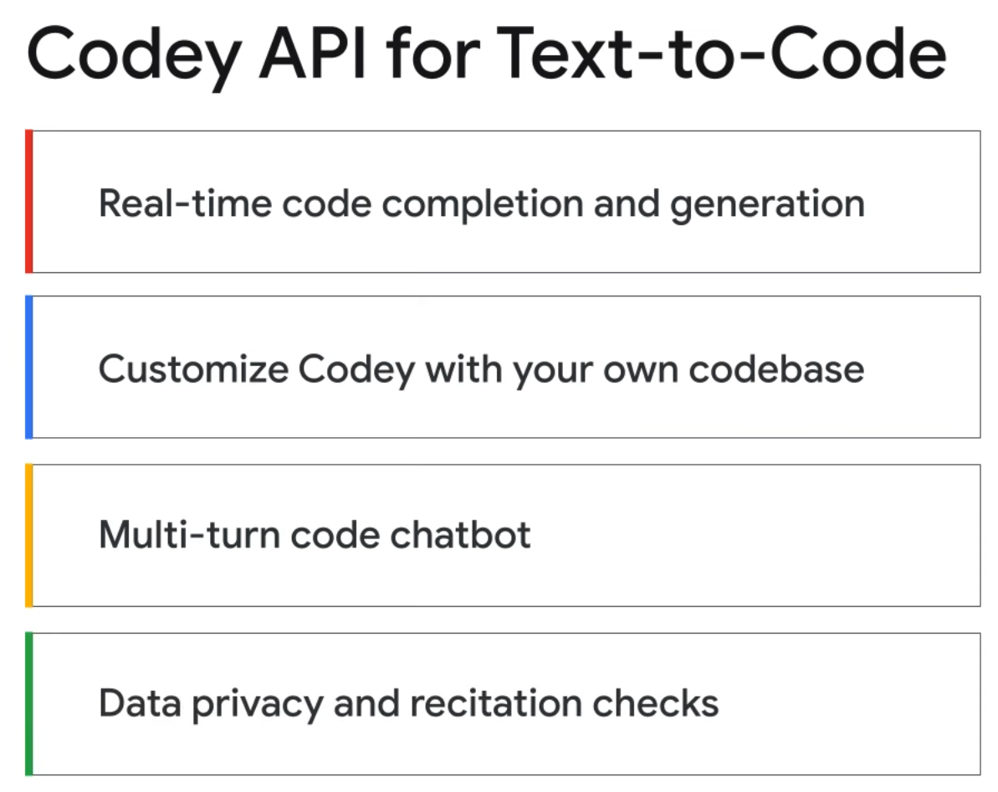
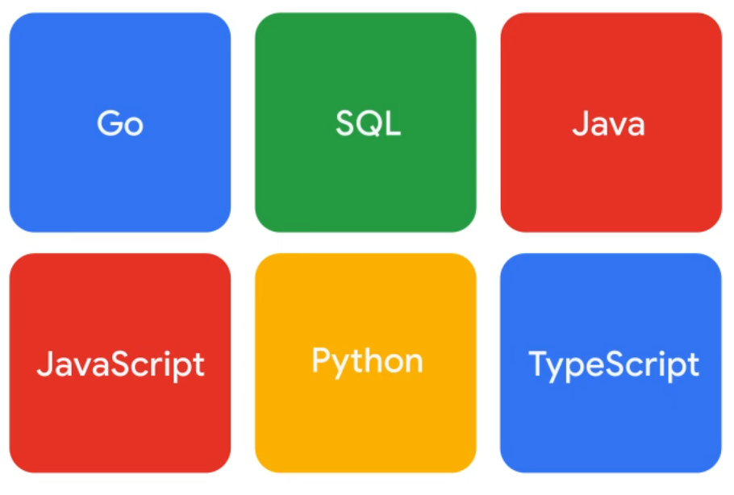

Slide 22
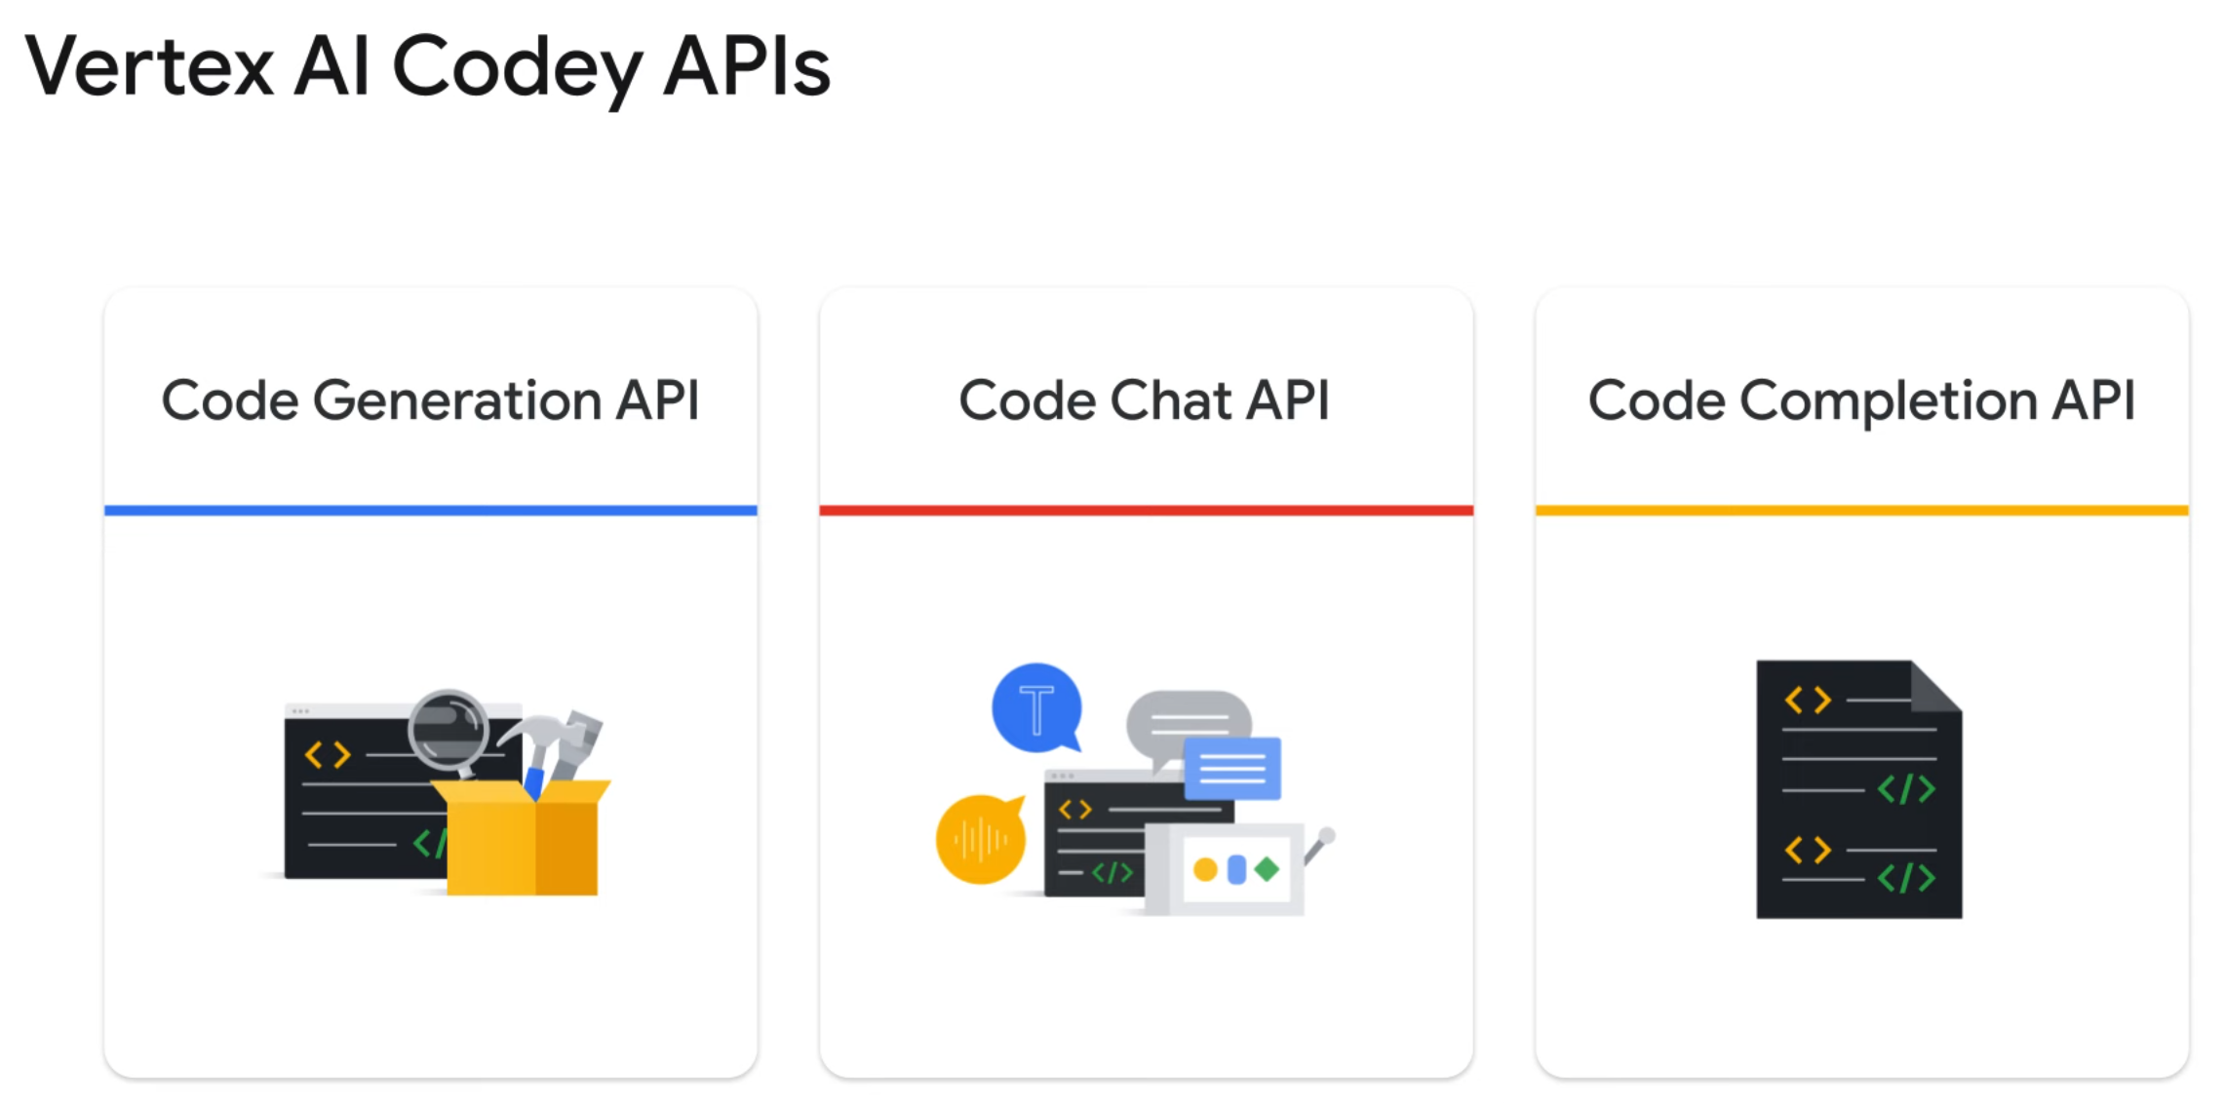

Slide 23
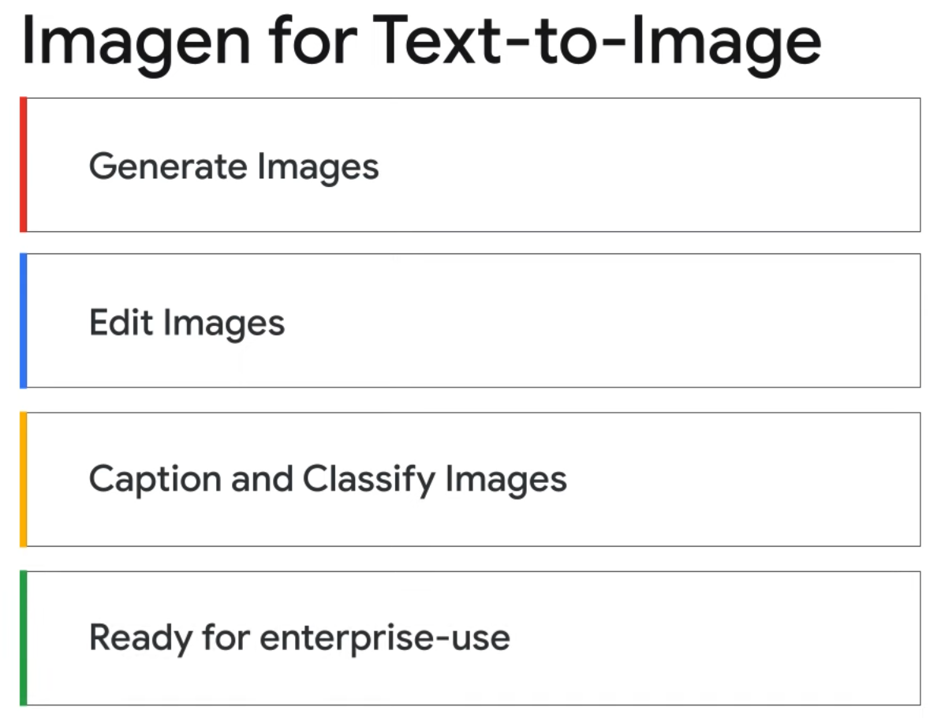

Slide 24
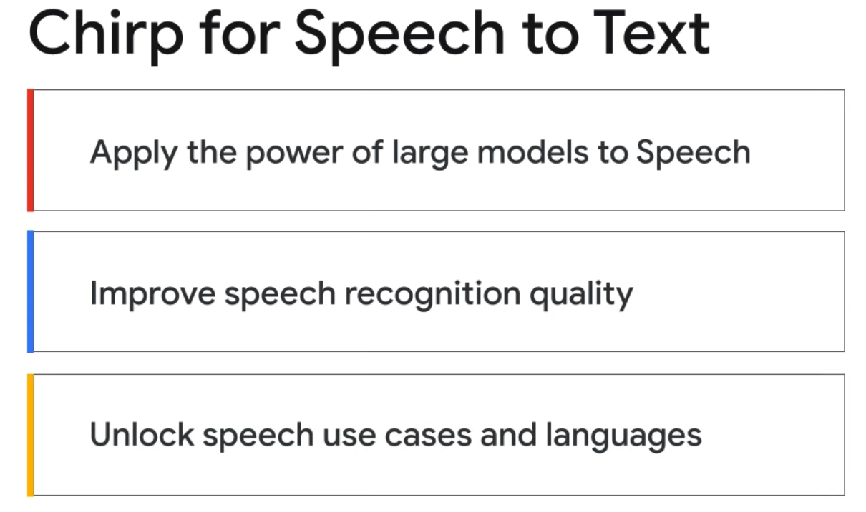

Slide 25


